Slide 1
Association Rule Mining
Apriori Algorithm

Slide 2
Frequent Itemset Generation
Brute-force approach:
Each itemset in the lattice is a candidate frequent itemset
Count the support of each candidate by scanning the database
Match each transaction against every candidate
Complexity ~ O(NMw) => Expensive since M = 2^{d} !!!

Slide 3
Frequent Itemset Generation Strategies
Reduce the number of candidates (M)
Complete search: M=2^{d} - 1
Use pruning techniques to reduce M
Reduce the number of transactions (N)
Reduce size of N as the size of itemset increases
Used by DHP and vertical-based mining algorithms
Reduce the number of comparisons (NM)
Use efficient data structures to store the candidates or transactions
No need to match every candidate against every transaction

Slide 7
Support Counting
Compare each tx. against every candidate itemset & update the support count of candidates contained in the tx.
Computationally expensive when no. of txs. & no. of candidates is large
How to make it efficient?
Enumerate all itemsets contained in a tx. & use them to update support counts of their respective CIs
T1 has {1,2,3,5,6}. ⁵C₃ = 10 itemsets of size 3. some of these 10 will correspond to C₃. Others are ignored.
How to make matching operation efficient?
Use HASH TREE!!!

Slide 8
Subset Operation
Given a transaction t, what are the possible subsets of size 3?

Slide 9
How to Count Supports of Candidates?
Method:
Candidate itemsets are stored in a hash-tree
Leaf node of hash-tree contains a list of itemsets and counts
Interior node contains a hash table
Subset function: finds all the candidates contained in a transaction
Notes:
9

Slide 10
Reducing Number of Comparisons
Candidate counting:
Scan the database of transactions to determine the support of each candidate itemset
To reduce the number of comparisons, store the candidates in a hash structure
Instead of matching each transaction against every candidate, match it against candidates contained in the hashed buckets

Slide 11
Hash Tree
Partition CIs into different buckets and store them in hash tree
During support counting, itemsets in each tx. are also hashed into their appropriate buckets using the same hash function
for C₂

Slide 12
Hash Tree
Example: 3-itemset
All candidate 3-itemsets are hashed
Enumerate all the 3-itemsets of the tx.
All 3-itemsets contained in a transaction are also hashed
Comparison of a 3-itemset of tx. with all candidate 3-itemsets is avoided
Comparison is required to be done only in the appropriate bucket
Saves time ☺

Slide 13
Generate Hash Tree
Suppose you have 15 candidate itemsets of length 3:
{1 4 5}, {1 2 4}, {4 5 7}, {1 2 5}, {4 5 8}, {1 5 9}, {1 3 6}, {2 3 4}, {5 6 7}, {3 4 5}, {3 5 6}, {3 5 7}, {6 8 9}, {3 6 7}, {3 6 8}
You need:
Hash function: For each internal node use hash fn. h(p) = p mod 3
All candidate itemsets are stored at the leaf nodes of the hash tree
Max leaf size: max number of itemsets stored in a leaf node (if number of candidate itemsets exceeds max leaf size, split the node)
Hash function
2 3 4
5 6 7
3,6,9
1,4,7
1 4 5
3 4 5
3 5 6
3 5 7
6 8 9
3 6 7
3 6 8
1 3 6
2,5,8
1 2 4
4 5 7
1 2 5
4 5 8
1 5 9

Slide 14
Example of the hash-tree for C₃
Hash function: mod 3
H
H
Hash on 1st item
1,4,..
2,5,..
3,6,..
H
234
567
H
Hash on 2nd item
145
H
345
356
357
689
367
368
Hash on 3rd item
136
124
457
125
458
159
Notes:
14

Slide 15
Example of the hash-tree for C₃
2356
look for 2XX
356
look for 3XX
Hash function: mod 3
12356
H
H
Hash on 1st item
12356
look for 1XX
1,4,..
2,5,..
3,6,..
H
234
567
H
Hash on 2nd item
145
H
345
356
357
689
367
368
Hash on 3rd item
124
457
125
458
159
Notes:
15

Slide 16
Example of the hash-tree for C₃
2356
look for 2XX
356
look for 3XX
Hash function: mod 3
12356
H
H
Hash on 1st item
12356
look for 1XX
1,4,..
2,5,..
3,6,..
H
234
567
H
Hash on 2nd item
12356
look for 12X
∅
145
H
345
356
689
367
368
12356
look for 13X (null)‏
124
457
125
458
159
12356
look for 15X
The subset function finds all the candidates contained in a transaction:
At the root level it hashes on all items in the transaction
At level i it hashes on all items in the transaction that come after item the i-th item
Notes:
16

Slide 17
Association Rule Discovery: Hash tree
Hash Function
Candidate Hash Tree
1,4,7
3,6,9
2,5,8
2 3 4
5 6 7
1 4 5
1 3 6
3 4 5
3 5 6
3 6 7
Hash on 1, 4 or 7
3 5 7
3 6 8
1 2 4
1 5 9
6 8 9
1 2 5
4 5 7
4 5 8

Slide 18
Association Rule Discovery: Hash tree
Hash Function
Candidate Hash Tree
1,4,7
3,6,9
2,5,8
2 3 4
5 6 7
1 4 5
1 3 6
3 4 5
3 5 6
3 6 7
Hash on 2, 5 or 8
3 5 7
3 6 8
1 2 4
1 5 9
6 8 9
1 2 5
4 5 7
4 5 8

Slide 19
Association Rule Discovery: Hash tree
Hash Function
Candidate Hash Tree
1,4,7
3,6,9
2,5,8
2 3 4
5 6 7
1 4 5
1 3 6
3 4 5
3 5 6
3 6 7
Hash on 3, 6 or 9
3 5 7
3 6 8
1 2 4
1 5 9
6 8 9
1 2 5
4 5 7
4 5 8

Slide 20
Subset Operation Using Hash Tree
Hash Function
1 2 3 5 6
transaction
1,4,7
3,6,9
1 +
2 3 5 6
2,5,8
2 +
3 5 6
3 +
5 6
2 3 4
5 6 7
1 4 5
1 3 6
3 4 5
3 5 6
3 6 7
3 5 7
3 6 8
1 2 4
1 2 5
1 5 9
6 8 9
4 5 7
4 5 8

Slide 21
Subset Operation Using Hash Tree
1 2 3 5 6
transaction
Hash Function
1 +
2 3 5 6
2 +
3 5 6
1,4,7
3,6,9
1 2 +
3 5 6
3 +
5 6
2,5,8
1 3 +
5 6
2 3 4
1 5 +
6
5 6 7
1 4 5
1 3 6
3 4 5
3 5 6
3 6 7
3 5 7
3 6 8
1 2 4
1 2 5
1 5 9
6 8 9
4 5 7
4 5 8

Slide 22
Subset Operation Using Hash Tree
1 2 3 5 6
transaction
Hash Function
1 +
2 3 5 6
2 +
3 5 6
1,4,7
3,6,9
1 2 +
3 5 6
3 +
5 6
2,5,8
1 3 +
5 6
2 3 4
1 5 +
6
5 6 7
1 4 5
1 3 6
3 4 5
3 5 6
3 6 7
3 5 7
3 6 8
1 2 4
1 2 5
1 5 9
6 8 9
4 5 7
4 5 8
Match transaction against 9 out of 15 candidates

Slide 23
Factors Affecting Complexity
Choice of minimum support threshold
lowering support threshold results in more frequent itemsets
this may increase number of candidates and max length of frequent itemsets
Dimensionality (number of items) of the data set
more space is needed to store support count of each item
if number of frequent items also increases, both computation and I/O costs may also increase
Size of database
since Apriori makes multiple passes, run time of algorithm may increase with number of transactions
Average transaction width
transaction width increases with denser data sets
This may increase max length of frequent itemsets and traversals of hash tree (number of subsets in a transaction increases with its width)

Slide 24
Computational Complexity
Factors affecting computational complexity of Apriori:
Min_sup
No. of items (dimensionality)
No. of transactions
Average transaction width

Slide 25
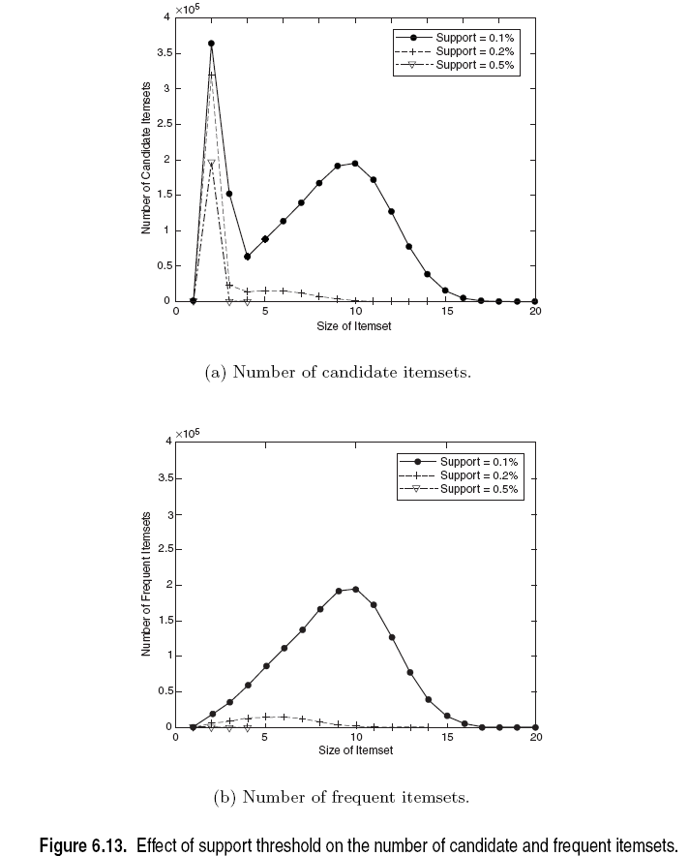

Slide 26
Computational Complexity
No. of items (dimensionality)
More space for storing support counts of items
If the no. of FIs grow with dim., the computation & I/O costs will increase because of the large no. of candidates generated by the algo.
No. of Transactions
Apriori makes repeated passes of the tr. DB
Run time increases as a result
Average Transaction width
Max. size of FIs increase as avg size of tx. Increases
More itemsets need to be examined during candidate generation and support counting
As width increases, more itemsets are contained in the tx. Will inc. the hash tree traversal

Slide 27
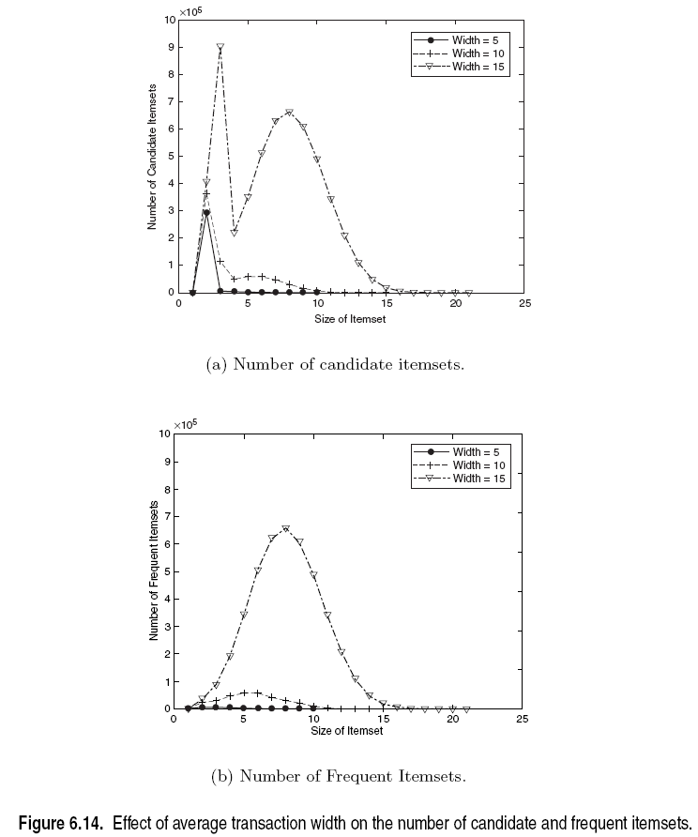

Slide 28
AR Generation from FIs
So far we have seen algorithms for finding FIs
Lets now look at how we can generate the ARs from FIs
FIs are concerned only with “support”
Time to bring in the concept of “confidence”
For each FI l, generate all non-empty subsets of l
For each non-empty subset s of l, output the rule
s → (l-s) if

Slide 29
AR Generation from FIs
For each k-FI, Y, we can have up to 2^{k}-2 ARs.
Ignore empty antecedents/consequents
Partition Y into 2 non-empty subsets X & Y-X, such that X→Y-X satisfies min_conf
We need not worry about min_sup!
Y={1,2,3}
6 candidate ARs: {1,2} →{3}, {1,3} →{2}, {2,3} →{1},
{1} →{2,3}, {2} →{1,3}, {3} →{1,2}
DO we need any additional scans to find confidence?
For {1,2} →{3}, the confidence is σ({1,2,3})/σ({1,2})
123 is frequent, therefore 12 is also frequent. So no need to find support counts again

Slide 30
Rule Generation
Given a frequent itemset L, find all non-empty subsets f ⊂ L such that f → L – f satisfies the minimum confidence requirement
If {A,B,C,D} is a frequent itemset, candidate rules:
ABC →D, ABD →C, ACD →B, BCD →A, A →BCD, B →ACD, C →ABD, D →ABC AB →CD, AC → BD, AD → BC, BC →AD, BD →AC, CD →AB,
If |L| = k, then there are 2^{k} – 2 candidate association rules (ignoring L → ∅ and ∅ → L)

Slide 31
Rule Generation
How to efficiently generate rules from frequent itemsets?
In general, confidence does not have an anti-monotone property
c(ABC →D) can be larger or smaller than c(AB →D)
But confidence of rules generated from the same itemset has an anti-monotone property
e.g., L = {A,B,C,D}: c(ABC → D) ≥ c(AB → CD) ≥ c(A → BCD)
Confidence is anti-monotone w.r.t. number of items on the RHS of the rule

Slide 32
Rule Generation for Apriori Algorithm
Low Confidence Rule
Lattice of rules
Pruned Rules

